Slide 1

Unified Communications &
Collaboration
UC Voice Marketing Toolkit

Slide 2
Program Summary
Implementation of Unified Communications and Collaboration (UCC) is a significant step in helping increase the effectiveness and efficiency of the workforce. However the adoption of new technology and ways of working can prove to be a complicated process to implement. On this site, we have created a set of assets that will help inform, inspire and educate your users about the transformational changes the company is going through.

Slide 3
Communications Strategy
Now that you have chosen a UC Voice solution certain operational steps need to be carried out. One of these steps is informing and educating your workforce and stakeholders with the right information, at the right time.
We have developed a full range of communications tools that can be deployed in a pre, launch and post-launch environment helping ensure the right message and call to action is conveyed.
Pre-Launch
2-3 weeks prior to deployment
Launch
Launch week
Post-Launch
2-4 weeks after deployment

Slide 4
Effective Communications Toolkit
The UCC “Campaign in a box”, is a ready to use resource kit which AT&T and Cisco have specifically designed to help you inform and communicate with your staff to make the transition to UCC as easy as possible. The kit contains:
Phased customizable emailers to inform your workforce of the transitions
(in different formats: word, html, oft Outlook)
Copy blocks for extending the campaign messaging to other
marketing activities – i.e. company intranet, internal blogs etc.
Online web banners (in Skyscraper, leaderboard and MPU formats) to help you promote useful information
Video assets – used to highlight some of the challenges that your UCC solution can help overcome
Digital user guide – a downloadable guide including top hints and tips
Microsite splash page – interface page for your UCC portal

Slide 5
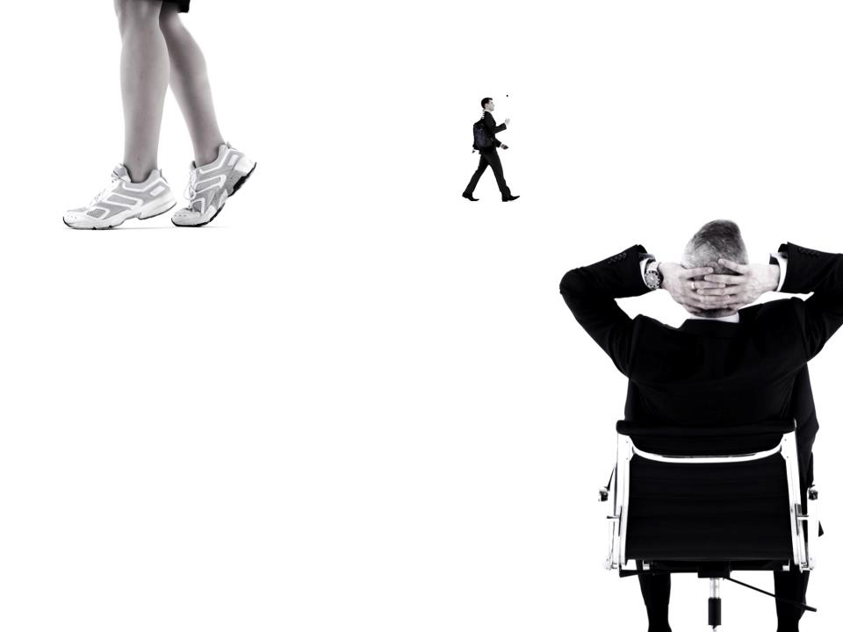
Pre-Launch Phase
Unified Communications &
Collaboration
Marketing Toolkit

Slide 6
Pre-Launch Phase Overview
Use this phase of the campaign prior to deploying your UCC solution. It’s recommended that these communications are deployed 2-3 weeks prior to launch.
This will generate intrigue into what’s about to happen as well as pre-empting users to visit the dedicated resource portal.
On the AT&T portal you locate and download the assets available in this phase of the campaign as well as other information that will aid with deployment.
Assets in this phase include:
  2 x pre-launch eDMs (HTML + OFT)
  Pre-launch video

Slide 7
Customizable Emails
Send these emails to your workforce to raise awareness that something is about to happen that can help improve their work collaboration experience.
Emails will drive the user to content, assets, information and FAQ’s that will help with the deployment of your UCC solution.
Customize the mailer/e-mailer with your personal information
(e-mail/website/phone number) and your company logo
Available in HTML and OFT formats

Slide 8
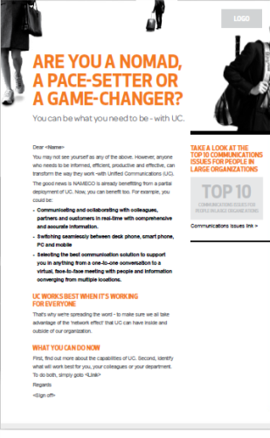
Customizable Emails - Example
Content and pictures are fixed except zones rounded in red, which you can customize as explained opposite.
Logo size – 50px height
Logo placement – top right hand corner
Body copy – Arial font size 12px, line hieght 16px – #666color
Headings - Arial font size 13px, line height 17px bold weight, text transform uppercase– #F5771Dcolor
Hyperlinks -Arial font size 12px, line height 16px – #3B90D0color

Slide 9
Customizable Emails
.doc Format: Word format
to be sent by e-mail in an attachment (the final doc should be converted to a pdf file)
.html in .zip file Format: Html language
In the zip folder, there are all the files you need (html file and pictures) to send an e-mail.
Please note, you should be familiar with html language and routing processes or be helped by a professional developer to use these files.
.oft Format: Outlook format
Best results can be reached with an OFT file when targeting Microsoft® Outlook users. If the recipient uses a different email client (ie. type Yahoo or Gmail), unexpected displaying can occur, such as losing the text formatting
The .oft file opens directly in Outlook; then you can edit it as an e-mail and customize the texts as explained above. Here are some practical tips, more information about layout in Appendix slides:
Insert your logo, a hyperlink to your site or your email following the same procedure as common Office documents (MS Word, PowerPoint).
Once customized, click on “save”: the template is automatically saved in the outlook draft folder

Slide 10
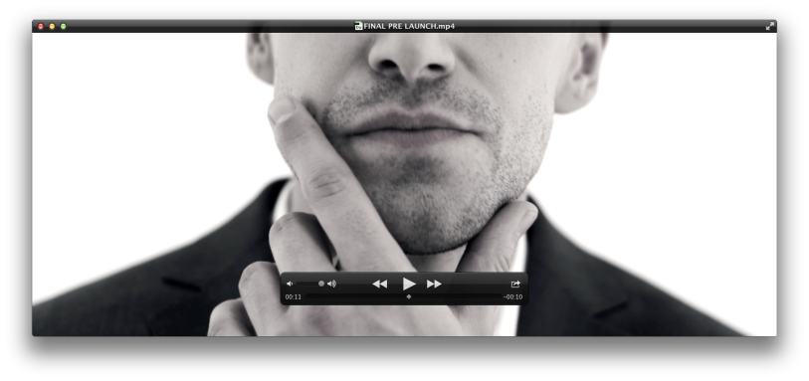
Pre-Launch Teaser video
Teaser content that introduces 3 main types of characters that can be associated with within an organization, this can be hosted on your intranet or portal.
The additional content will relate to the benefits UCC can have on these 3 characters.
File formats available include WMV and MP4.

Slide 11
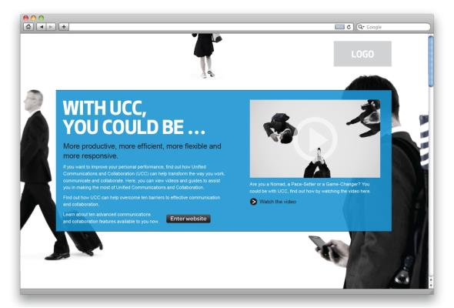
Landing Page Creative
Customizable landing page that can be used as the front door to your UCC adoption campaign
Available in HTML, InDesign and PDF formats dependant on your internal web teams requirements

Slide 12
Launch Phase
Unified Communications &
Collaboration
Marketing Toolkit

Slide 13
Launch Phase Overview
Use the assets in this section in conjunction with deployment. Communicate with the end users about how utilizing UCC in the work place can help drive a more efficient way of collaborating.
Here we introduce some of the flexibility, productivity and efficiency benefits workers can expect from UCC.
The information in the launch phase can be used to orientate users with the changes as well as providing FAQs to some of the challenges/issues they may have. Assets include:
  2 x launch eDMs (HTML + OFT)
  3 x launch videos (Nomad, Pace Setter, Game Changer introductions)
  Online Ad suite (skyscraper, MPU and Leaderboard formats)
  Social copy blocks – ‘10 key communications issues’

Slide 14
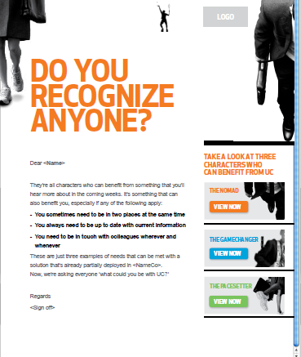
Customizable Emails - Example
Here we can help facilitate the deployment of your UCC solution. You can highlight the specific elements of the campaign. We have also introduced some of the behaviors that your staff can relate to, and how UCC can benefit them.
Content and pictures are fixed except zones rounded in red, where you are able to customize as explained opposite.

Slide 15
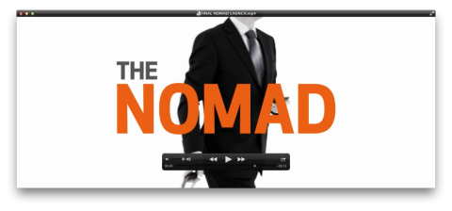
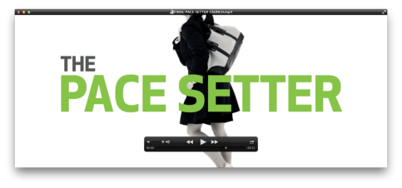
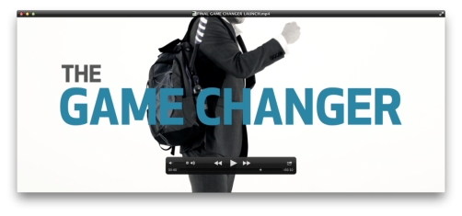
Launch Videos
Here we introduce 3 characters to the campaign in the form of video (the Nomad – a typical mobile worker, The Pacesetter – balancing work/life commitments and schedules and the Game Changer – who uses UCC to help provide a business advantage
File formats available include - WMV and MP4

Slide 16
Copy Blocks
Copy blocks have been created that allow you to extend adoption messaging to many different communication activities. These copy blocks help provide a consistent voice on intranet content, blogs, social networking or newsletters.
The ‘10 key communications issues’ copy blocks highlight some of the day to day issues employees face when UCC has not been deployed - which can now be a thing of the past.

Slide 17
Online Web Banners
In order to help you to promote the campaign portal and associated assets to your workforce, AT&T and Cisco have designed a suite of online ads for use on your internal websites .
Banners: Available in GIF formats in MPU, Skyscraper and Leaderboard formats.
Static GIF files are also available.

Slide 18



Online Web Banners - Examples
3 sizes are available of each static and animated web banners
Banner_729x90
Banner_300x250
Banner_160x600

Slide 19
Post-Launch Phase
Unified Communications &
Collaboration
Marketing Toolkit

Slide 20
Post -Launch Phase Overview
Your UCC deployment has now been integrated into the workforce and users are becoming more comfortable with the technology. Now is the time to maximize the benefit of your investment by elevating some of the functions that the technology can deliver.
In this section we get up close and personal with some of the features and functions UCC has to offer for your UC Voice solution, for example its illustrated how Single Number Reach can be utilized to contact a colleague regardless of device or location.
Assets for this phase include:
  1 x post launch eDM (HTML + OFT)
  Post Launch Videos x1
  Social copy blocks – ‘10 key features of UCC’

Slide 21
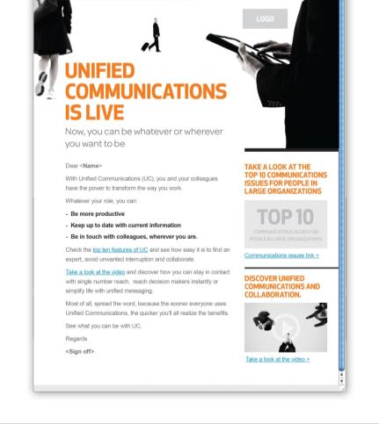
Customizable Emails - Example
Some of the features of the solutions can be highlighted in this phase of the communication. Specific product information can be highlighted.
Content and pictures are fixed except zones rounded in red which you can customize as explained opposite.

Slide 22
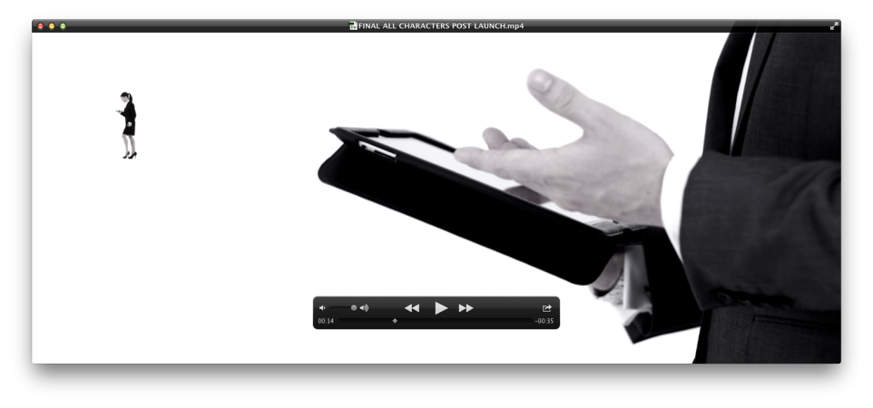
Post-Launch Video – UC Voice
Feature/function specific videos that highlight some of the benefits that the UC Voice technology provides.
File formats available include - WMV and MP4

Slide 23
Copy Blocks
Copy blocks have been created that allow you to extend adoption messaging to many different communication activities. These copy blocks help provide a consistent voice on intranet content, blogs, social networking or newsletters.
The ‘10 Key Features of UCC’ copy blocks highlight some of the advanced functionality that your solution can provide.

Slide 24
Appendix
Unified Communications &
Collaboration
Marketing Toolkit

Slide 25
Importing HTML file to Outlook?
Import the HTML file to the stationery folder of your computer.
To quickly locate your stationery folder:
In Office 2003/2007: Tools > Options > tab Mail Format > hold CTRL when clicking on the "Stationery and Fonts..." button.
In Office 2010: File > Options > Mail
Here you must place your html files and all images in the stationery folder

Slide 26
How to insert text in an .oft file?
To overwrite the placeholder address start typing in the middle of it to preserve the formatting.
You can delete the letters at the beginning and/or end of the address later
Colors and fonts can be amended as well.

Slide 27
Editing a pre-set .oft hyperlink?
If its an email address keep the “mailto:” in front of the address. If you’d rather link to your website don’t forget the “http://” characters in front of the URL.
To change the hyperlink - highlight link, click insert on the toolbar and select hyperlink.
If there is already a link in the address box delete it. either type in or paste the new link in to the address field with the relevant prefix and press ok.

Slide 28
Modifying images in an .oft file
In office 2007 and 2010 changing the image is very easy. Just right click the placeholder image and select the “change picture” option.
Outlook will automatically keep the original dimensions. You can change them by dragging the corners.
Don’t try to make your logo higher than the placeholder was, otherwise you may dislocate the HTML artwork.
In office 2003 you’ll need to remove the placeholder file and paste in the new picture.

Slide 29
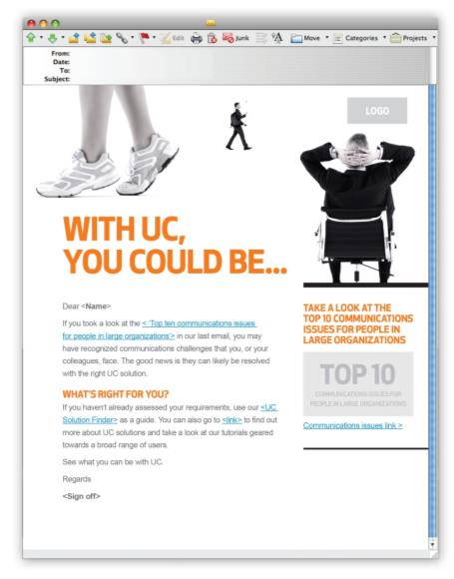
What to modify in an HTML file?
‘Subject line’ and ‘From’ email address/name
Personalize accordingly
Insert company logo
Tailor your communications
Personalization
Insert recipients name
Call To Action
Insert relevant CTA description and URL link
Signatory
Insert contact details and signatory
Legal
Insert legal’s, T&C and unsubscribe link if applicable

Slide 30
Modifying online banners?
Leaderboard Banner_729x90
All of the online banners are unbranded.
Use them to drive traffic to assets dedicated your UC deployment.
Insert URL on overlay on GIF versions .
MPU Banner_300x250
Skyscraper Banner_160x600

